Slide 1
Chapter 4: GUI
Storing Data in Our MySQL Database
via Our GUI

Slide 2
Storing Data in Our MySQL Database
via Our GUI
In this chapter, we will learn how to install and use a MySQL database and connect it to our GUI.
MySQL is a full-fledged Structured Query Language (SQL) database server and comes with a very nice GUI of its own so that we can view and work with the data. We will create a database, insert data into our database, and then see how we can modify, read, and delete data.
Here, you will learn how to increase your programming skills by adding SQL to your programming toolbox.
The first recipe in this chapter will show you how to install the free MySQL Community Edition.

Slide 3
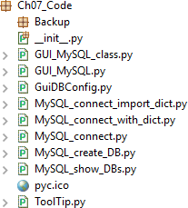
Storing Data in Our MySQL Database via Our GUI Chapter 7
In this chapter, we will enhance our Python GUI by connecting the GUI to a MySQL database.
Content:
Installing and connecting to a MySQL server from Python
Configuring the MySQL database connection
Designing the Python GUI database
Using the SQL INSERT command
Using the SQL UPDATE command
Using the SQL DELETE command
Storing and retrieving data from our MySQL database
Using MySQL Workbench

Slide 4
Storing Data in Our MySQL Database via Our GUI Chapter 7
1_ Installing and connecting to a MySQL server from Python
Before we can connect to a MySQL database, we have to connect to the MySQL server. In order to do this, we need to know the IP address of the MySQL server as well as the port it is listening on.
We also have to be a registered user with a password in order to be authenticated by the MySQL server.
Getting ready
You will need to have access to a running MySQL server instance, as well as have administrator privileges in order to create databases and tables.

Slide 5

Storing Data in Our MySQL Database via Our GUI Chapter 7
How to do it…
Let's look at how to install and connect to a MySQL server from Python:
1. Download the MySQL Installer.
There is a free MySQL Community Edition available from the official MySQL website. You can download and install it on your local PC from http://dev.mysql.com/downloads/windows/installer/.

Slide 6
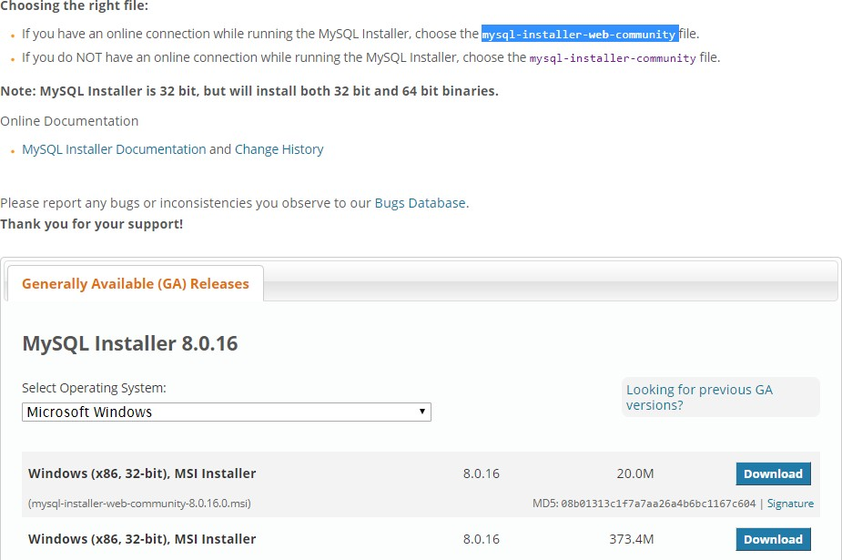
Storing Data in Our MySQL Database via Our GUI
Chapter 7
2. Run the installation:

Slide 7
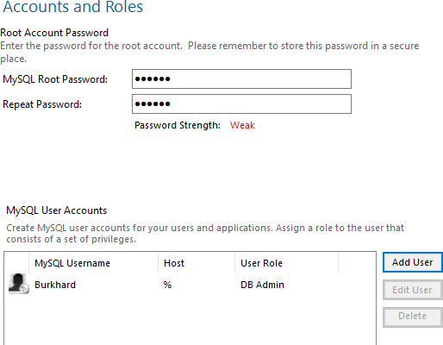
Storing Data in Our MySQL Database via Our GUI
Chapter 7
3. Choose a password for the root user and, optionally, add more users:

Slide 8
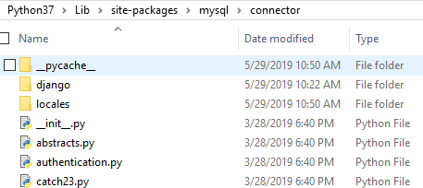
Storing Data in Our MySQL Database via Our GUI
Chapter 7
4. Verify that you have the \Python37\Lib\site- packages\mysql\connector folder:

Slide 9
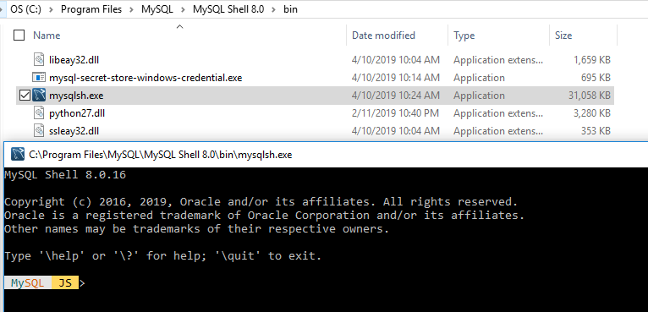
Storing Data in Our MySQL Database via Our GUI
Chapter 7
5. Open the mysqlsh.exe executable and double-click on it to run it:

Slide 10
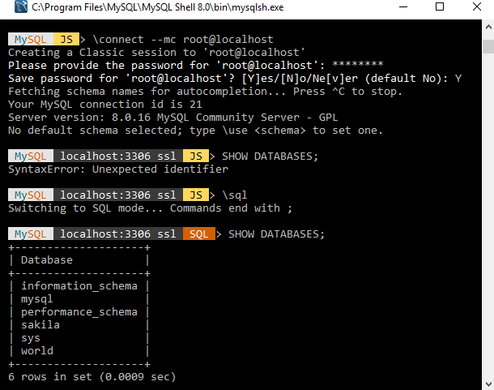
Storing Data in Our MySQL Database via Our GUI
Chapter 7
Type \sql in the prompt to get into SQL mode.
In the MySql> prompt, type SHOW DATABASES.
Then, press Enter:

Slide 11

Storing Data in Our MySQL Database via Our GUI
Chapter 7
Create a new Python module and save it as MySQL_connect.py:
import mysql
conn = mysql.connector.connect(user=<adminUser>, password=<adminPwd>, host='127.0.0.1')
print(conn)
conn.close()
If running the preceding code results in the following output, then we have successfully connected:

Slide 12
2_ Configuring the MySQL database connection
Storing Data in Our MySQL Database via Our GUI Chapter 7
In the previous recipe, we used the shortest way to connect to a MySQL server, that is, by hardcoding the credentials that are required for authentication in the connect method. While this is a fast approach for early development, we definitely do not want to expose our MySQL server credentials to anyone. Instead, we want to grant permission to specific users so that they can access databases, tables, views, and related database commands.
A much safer way to be authenticated by a MySQL server is by storing the credentials in a configuration file, which is what we will do in this recipe. We will use our configuration file to connect to the MySQL server and then create our own database on the MySQL server.

Slide 13

Storing Data in Our MySQL Database via Our GUI Chapter 7
Getting ready
Access to a running MySQL server with administrator privileges is required to run the code shown in this recipe.
The previous recipe shows how to install the free Community Edition of MySQL server. The administrator privileges will allow you to implement this recipe.

Slide 14
Storing Data in Our MySQL Database via Our GUI Chapter 7
How to do it…
Let's look at how to perform this recipe:
1.First, we will create a dictionary in the same module where the MySQL_connect.py code is. Sequentially, we will do the following:
1.Open MySQL_connect.py and save it as MySQL_connect_with_dict.py.
2. Add the following code to the module:
# create dictionary to hold connection info
dbConfig = {
# use your admin name
# use your real password
# IP address of localhost
'user': <adminName>,
'password': <adminPwd>,
'host': '127.0.0.1',
}

Slide 15
Storing Data in Our MySQL Database via Our GUI
Chapter 7
Write the following code below dbConfig:
import mysql.connector
# unpack dictionary credentials
conn = mysql.connector.connect(**dbConfig) print(conn)
Run the code to make sure it works.

Slide 16
Storing Data in Our MySQL Database via Our GUI
Chapter 7
4.Create a new module, GuiDBConfig.py, and place the following code in it:
# create dictionary to hold connection info dbConfig = {
# your user name
# your password
# IP address
'user': <adminUser>,
'password': <adminPwd>,
'host': '127.0.0.1’,
}

Slide 17
Storing Data in Our MySQL Database via Our GUI
Chapter 7
5.Now, open MySQL_connect_with_dict.py and save it as MySQL_connect_import_dict.py.
6.Import GuiDBConfig and unpack the dictionary, as shown here:
import GuiDBConfig as guiConf
# unpack dictionary credentials
conn = mysql.connector.connect(**guiConf.dbConfig) print(conn)

Slide 18
Storing Data in Our MySQL Database via Our GUI
Chapter 7
Create a new Python module and save it as MySQL_create_DB.py. Next, add the following code:
import mysql.connector
import Ch07_Code.GuiDBConfig as guiConf
GUIDB = 'GuiDB'
# unpack dictionary credentials
conn = mysql.connector.connect(**guiConf.dbConfig)
cursor = conn.cursor()

Slide 19

Storing Data in Our MySQL Database via Our GUI Chapter 7
try:
cursor.execute("CREATE DATABASE {}
DEFAULT CHARACTER SET 'utf8'".format(GUIDB))
except mysql.connector.Error as err:
print("Failed to create DB: {}".format(err))
conn.close()
8. Execute MySQL_create_DB.py twice:

Slide 20
Storing Data in Our MySQL Database via Our GUI Chapter 7
Create a new Python module and save it as MySQL_show_DBs.py. Then, add the following code:
import mysql.connector
import GuiDBConfig as guiConf
# unpack dictionary credentials
conn = mysql.connector.connect(**guiConf.dbConfig)
cursor = conn.cursor()
cursor.execute("SHOW DATABASES") print(cursor.fetchall())
conn.close()

Slide 21

Storing Data in Our MySQL Database via Our GUI Chapter 7
Running the preceding code gives us the following output:

Slide 22
3_ Designing the Python GUI database
Storing Data in Our MySQL Database via Our GUI Chapter 7
Before we start creating tables and inserting data into them, we have to design the database. Unlike changing local Python variable names, changing a database schema once it has been created and loaded with data is not that easy.
We would have to DROP the table, which means we would lose all the data that was in the table. So, before dropping a table, we would have to extract the data, save the data in a temporary table or other data format, and then DROP the table, recreate it, and finally reimport the original data.
I hope you are getting the picture of how tedious this could be.

Slide 23
Storing Data in Our MySQL Database via Our GUI Chapter 7
Designing our GUI MySQL database means that we need to think about what we want our Python application to do with it and then choose names for our tables that match the intended purpose.
Getting ready
We will be working with the MySQL database we created in the previous recipe, Configuring the MySQL database connection. A running instance of MySQL is necessary and the two previous recipes show you how to install MySQL, all the necessary additional drivers, and how to create the database we are using in this chapter.

Slide 24
Storing Data in Our MySQL Database via Our GUI Chapter 7
How to do it…
In this recipe, we are starting with the GUI_TCP_IP.py file from the previous chapter. We will move the widgets from our Python GUI between the two tabs we created in the previous recipes in order to organize our Python GUI so that it can connect to a MySQL database. Let's take a look at how can we complete this recipe:
Open GUI_TCP_IP.py and save it as GUI_MySQL.py.
Download the full code from the Packt website.

Slide 25
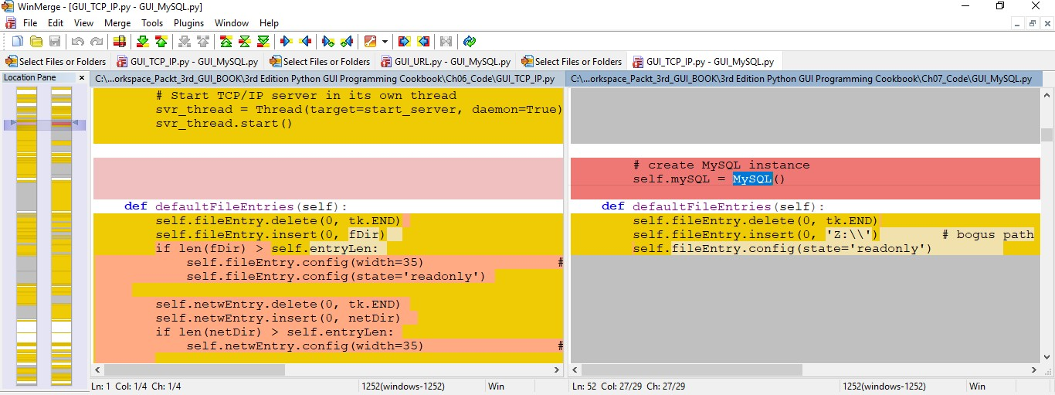
Storing Data in Our MySQL Database via Our GUI Chapter 7
3.Use a tool such as WinMerge to compare the two versions of the GUI:

Slide 26
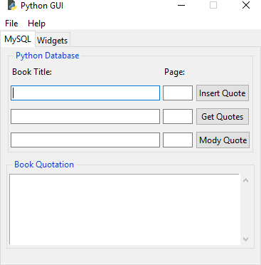
Storing Data in Our MySQL Database via Our GUI
Chapter 7
4. Run the code located in GUI_MySQL.py. You will observe the following output:

Slide 27
Storing Data in Our MySQL Database via Our GUI
Chapter 7
Now, open MySQL_create_DB.py and save it as MySQL_show_DB.py.
Replace the try...catch block with the following code:
# unpack dictionary credentials
conn = mysql.connect(**guiConf.dbConfig)
# create cursor
cursor = conn.cursor()
# execute command
cursor.execute("SHOW TABLES FROM guidb") print(cursor.fetchall())
# close connection to MySQL
conn.close()

Slide 28
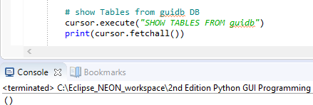
Storing Data in Our MySQL Database via Our GUI
Chapter 7
5. Run the code and observe the output:

Slide 29
Storing Data in Our MySQL Database via Our GUI
Chapter 7
Create a module similar to GUI_MySQL_class.py.
Add and run the following code:
# connect by unpacking dictionary credentials
conn = mysql.connect(**guiConf.dbConfig)
# create cursor
cursor = conn.cursor()
# select DB cursor.execute("USE guidb")
# create Table inside DB
cursor.execute("CREATE TABLE Books (
Book_ID INT NOT NULL AUTO_INCREMENT,
Book_Title VARCHAR(25) NOT NULL,
Book_Page INT NOT NULL,
PRIMARY KEY (Book_ID)
) ENGINE=InnoDB")
# close connection to MySQL
conn.close()

Slide 30
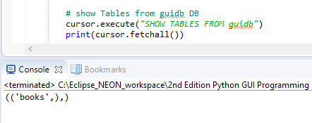
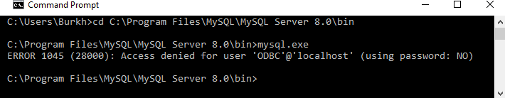
Storing Data in Our MySQL Database via Our GUI
Chapter 7
6. Run the following code, which is located in GUI_MySQL_class.py:
7. Open Command Prompt and navigate to mysql.exe:

Slide 31
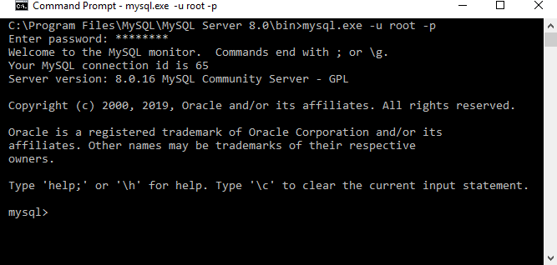
Storing Data in Our MySQL Database via Our GUI
Chapter 7
8. Run mysql.exe:

Slide 32
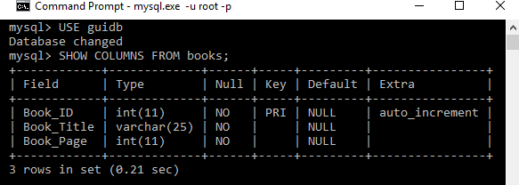
Storing Data in Our MySQL Database via Our GUI
Chapter 7
9. Enter the SHOW COLUMNS FROM books; command:

Slide 33
Storing Data in Our MySQL Database via Our GUI
Chapter 7
Create a second table by running the following code:
# select DB
cursor.execute("USE guidb")
# create second Table inside DB
cursor.execute("CREATE TABLE Quotations (
Quote_ID INT,
Quotation VARCHAR(250),
Books_Book_ID INT,
FOREIGN KEY (Books_Book_ID)
REFERENCES Books(Book_ID)
ON DELETE CASCADE
) ENGINE=InnoDB")

Slide 34
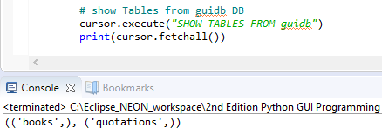
Storing Data in Our MySQL Database via Our GUI
Chapter 7
Execute the SHOW TABLES command:

Slide 35
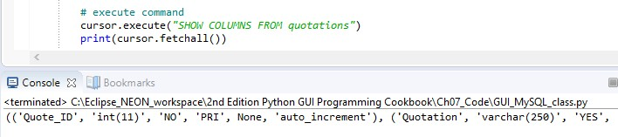
Storing Data in Our MySQL Database via Our GUI
Chapter 7
12. Execute the SHOW COLUMNS command:

Slide 36
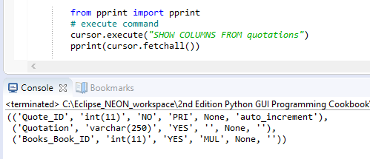
Storing Data in Our MySQL Database via Our GUI
Chapter 7
13. Execute SHOW COLUMNS again with pprint:

Slide 37
Storing Data in Our MySQL Database via Our GUI Chapter 7
4_ Using the SQL INSERT command
This recipe presents the entire Python code that shows you how to create and drop MySQL databases and tables, as well as how to display the existing databases, tables, columns, and data of our MySQL instance.
After creating the database and tables, we will insert data into the two tables we will create in this recipe.
We are using a primary key to foreign key relationship to connect the data of the two tables.
We will go into detail about how this works in the following two recipes, where we will modify and delete the data in our MySQL database.

Slide 38
Storing Data in Our MySQL Database via Our GUI Chapter 7
Getting ready
This recipe builds on the MySQL database we created in the previous recipe, Designing the Python GUI database, and also shows you how to drop and recreate the GuiDB.
Dropping the database, of course, deletes all the data the database has in its tables, so we'll show you how to reinsert that data as well.

Slide 39
How to do it…
Storing Data in Our MySQL Database via Our GUI Chapter 7
The entire code in the GUI_MySQL_class.py module is present in the code folder for this chapter, which you can download from https://github.com/PacktPublishing/Python- GUI-Programming-Cookbook-Third-Edition.
Download the code for this chapter.
Open GUI_MySQL_class.py and look at the class methods:
import mysql.connector
import Ch07_Code.GuiDBConfig as guiConf

Slide 40
Storing Data in Our MySQL Database via Our GUI Chapter 7
class MySQL(): # class variable GUIDB = 'GuiDB'
#------------------------------------------------------
def connect(self):
# connect by unpacking dictionary credentials
# create cursor
#------------------------------------------------------
def close(self, cursor, conn): # close cursor
#------------------------------------------------------
def showDBs(self): # connect to MySQL
#------------------------------------------------------
def createGuiDB(self): # connect to MySQL
#------------------------------------------------------
def dropGuiDB(self): # connect to MySQL
#------------------------------------------------------

Slide 41
Storing Data in Our MySQL Database via Our GUI Chapter 7
#------------------------------------------------------
def useGuiDB(self, cursor): '''Expects open connection.'''
# select DB
#------------------------------------------------------
def createTables(self): # connect to MySQL
# create Table inside DB
#------------------------------------------------------
def dropTables(self): # connect to MySQL
#------------------------------------------------------
def showTables(self): # connect to MySQL
#------------------------------------------------------

Slide 42
Storing Data in Our MySQL Database via Our GUI
Chapter 7
def insertBooks(self,title, page, bookQuote): # connect to MySQL
# insert data
#------------------------------------------------------
def insertBooksExample(self): # connect to MySQL
# insert hard-coded data
#------------------------------------------------------
def showBooks(self): # connect to MySQL
#------------------------------------------------------
def showColumns(self): # connect to MySQL
#------------------------------------------------------
def showData(self): # connect to MySQL
#------------------------------------------------------
if name == ' main ‘: # Create class instance
mySQL = MySQL()

Slide 43
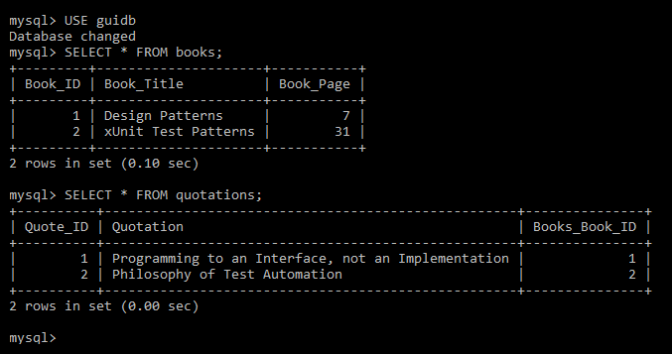
Storing Data in Our MySQL Database via Our GUI
Chapter 7
Running the preceding code (including the full implementation of the code) creates the following tables and data in the database we created.
Open Command Prompt and execute the two SELECT * statements:

Slide 44
Storing Data in Our MySQL Database via Our GUI
Chapter 7
5_ Using the SQL UPDATE command
This recipe will use the code from the previous recipe, Using the SQL INSERT command, explain it in more detail, and then extend the code to update the data.
In order to update the data that we previously inserted into our MySQL database tables, we need to use the SQL UPDATE command.
Getting ready
This recipe builds on the previous recipe, Using the SQL INSERT command, so read and study the previous recipe in order to follow the code in this recipe, where we will modify the existing data.

Slide 45
Storing Data in Our MySQL Database via Our GUI
Chapter 7
How to do it…
Let's take a look at how we can use the SQL UPDATE command:
First, we will display the data to be modified by running the following Python to the MySQL command. Sequentially, we perform the following steps:
Open GUI_MySQL_class.py.
Look at the showData method:
import mysql.connector
import Ch07_Code.GuiDBConfig as guiConf

Slide 46
Storing Data in Our MySQL Database via Our GUI
Chapter 7
class MySQL():
# class variable GUIDB = 'GuiDB'
#------------------------------------------------------
def showData(self):
# connect to MySQL
conn, cursor = self.connect()
self.useGuiDB(cursor) # execute command
cursor.execute("SELECT * FROM books") print(cursor.fetchall())
cursor.execute("SELECT * FROM quotations") print(cursor.fetchall())
# close cursor and connection self.close(cursor, conn)
#==========================================================

Slide 47
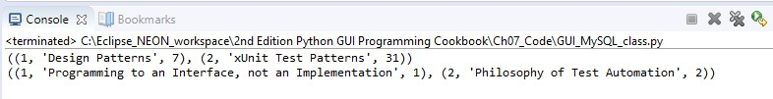
Storing Data in Our MySQL Database via Our GUI
Chapter 7
#=================================================
if name == ' main ': # Create class instance mySQL = MySQL()
mySQL.showData()
2. Running the preceding code gives us the following output:

Slide 48
Storing Data in Our MySQL Database via Our GUI
Chapter 7
3.Look at the updateGOF method:
#------------------------------------------------------
def updateGOF(self):
# connect to MySQL
conn, cursor = self.connect()
self.useGuiDB(cursor)
# execute command
cursor.execute("SELECT Book_ID FROM books WHERE Book_Title = 'Design Patterns'")
primKey = cursor.fetchall()[0][0]
print("Primary key=" + str(primKey))
cursor.execute("SELECT*FROM quotations WHERE Books_Book_ID =(%s)", (primKey,))
print(cursor.fetchall())
# close cursor and connection
self.close(cursor, conn)
#==========================================================
if name == ' main ':
mySQL = MySQL() # Create class instance mySQL.updateGOF()

Slide 49
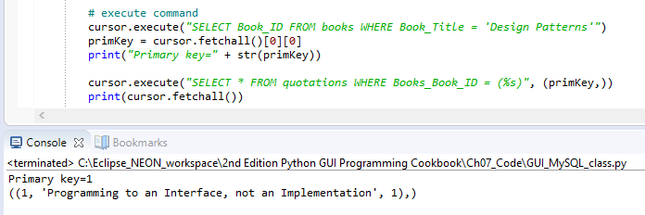
Storing Data in Our MySQL Database via Our GUI
Chapter 7
Run the method located in GUI_MySQL_class.py:

Slide 50
Storing Data in Our MySQL Database via Our GUI
Chapter 7
5. Add the following code and run it:
#--------------------------------------------------
def showDataWithReturn(self): # connect to MySQL
conn, cursor = self.connect()
self.useGuiDB(cursor) # execute command
cursor.execute("SELECT Book_ID FROM books WHERE Book_Title = 'Design Patterns'")
primKey = cursor.fetchall()[0][0] print(primKey)
cursor.execute("SELECT * FROM quotations WHERE Books_Book_ID = (%s)", (primKey,))
print(cursor.fetchall())

Slide 51
Storing Data in Our MySQL Database via Our GUI
Chapter 7
cursor.execute("UPDATE quotations SET Quotation=(%s) WHERE Books_Book_ID = (%s)",("Pythonic Duck Typing: If it walks like a duck and talks like a duck it probably is a duck...", primKey))
# commit transaction conn.commit ()
cursor.execute("SELECT * FROM quotations WHERE Books_Book_ID = (%s)", (primKey,))
print(cursor.fetchall())
# close cursor and connection self.close(cursor, conn)
#==========================================================

Slide 52
Storing Data in Our MySQL Database via Our GUI
Chapter 7
#==================================================
if name == ' main ':
# Create class instance
mySQL = MySQL()
#------------------------
mySQL.updateGOF()
book, quote = mySQL.showDataWithReturn()
print(book, quote)

Slide 53
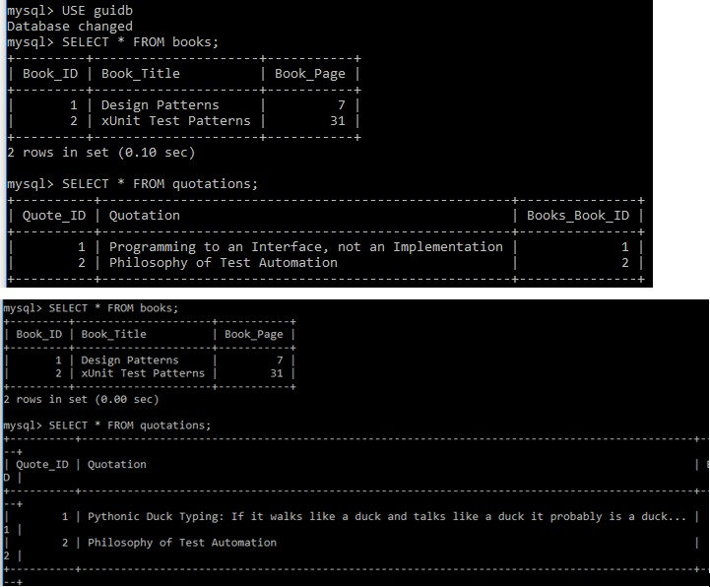
Storing Data in Our MySQL Database via Our GUI
Chapter 7
6. Open a MySQL client window and run the SELECT * statements:

Slide 54
Storing Data in Our MySQL Database via Our GUI
Chapter 7

Slide 55
Storing Data in Our MySQL Database via Our GUI Chapter 7
6_ Using the SQL DELETE command
In this recipe, we will use the SQL DELETE command to delete the data we created in the previous recipe, Using the SQL UPDATE command.
While deleting data might sound trivial at first, once we get a rather large database design in production, things might not be that easy any more.
Because we have designed our GUI database by relating two tables via a primary to foreign key relation, when we delete certain data, we do not end up with orphan records because this database design takes care of cascading deletes.

Slide 56

Storing Data in Our MySQL Database via Our GUI Chapter 7
Getting ready
This recipe uses the MySQL database, tables, and the data that was inserted into those tables from the previous recipe, Using the SQL UPDATE command. In order to demonstrate how to create orphan records, we will have to change the design of one of our database tables.
Changing the design to intentionally create a poor design is for demonstration purposes only and is not the recommended way of designing a database.

Slide 57
Storing Data in Our MySQL Database via Our GUI Chapter 7
How to do it…
If we create our quotations table without a foreign key relationship to the books table, we can end up with orphan records. Take a look at the following steps:
Open GUI_MySQL_class.py and look at def createTablesNoFK(self):
...:
# create second Table inside DB --
# No FOREIGN KEY relation to Books Table cursor.execute("CREATE TABLE Quotations (
Quote_ID INT AUTO_INCREMENT,
Quotation VARCHAR(250), Books_Book_ID INT, PRIMARY KEY (Quote_ID)
) ENGINE=InnoDB")

Slide 58
Storing Data in Our MySQL Database via Our GUI Chapter 7
Run the SQL command:
cursor.execute("DELETE FROM books WHERE Book_ID = 1")

Slide 59
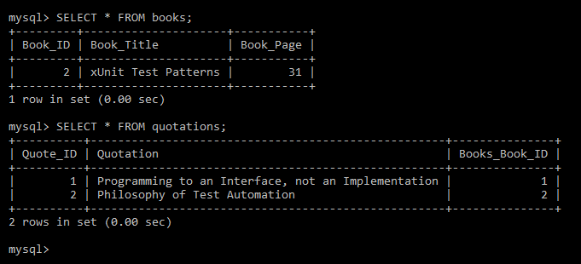
Storing Data in Our MySQL Database via Our GUI
Chapter 7
3. Run the two SELECT * commands:

Slide 60
Storing Data in Our MySQL Database via Our GUI
Chapter 7
4. Open GUI_MySQL_class.py and look at def createTables(self): ...:
# create second Table inside DB cursor.execute("CREATE TABLE Quotations (
Quote_ID INT AUTO_INCREMENT,
Quotation VARCHAR(250), Books_Book_ID INT, PRIMARY KEY (Quote_ID),
FOREIGN KEY (Books_Book_ID) REFERENCES Books(Book_ID) ON DELETE CASCADE
) ENGINE=InnoDB")
#==========================================================
if name == ' main ': # Create class instance mySQL = MySQL()
mySQL.showData()

Slide 61

Storing Data in Our MySQL Database via Our GUI
Chapter 7
5. Run the showData() method:

Slide 62
Storing Data in Our MySQL Database via Our GUI
Chapter 7
6. Run the deleteRecord() method, followed by the showData() method:
import mysql.connector
import Ch07_Code.GuiDBConfig as guiConf
class MySQL():
#------------------------------------------------------
def deleteRecord(self): # connect to MySQL
conn, cursor = self.connect()
self.useGuiDB(cursor) # execute command
cursor.execute("SELECT Book_ID FROM books WHERE Book_Title
=
'Design Patterns'")
primKey = cursor.fetchall()[0][0]
# print(primKey)

Slide 63
Storing Data in Our MySQL Database via Our GUI
Chapter 7
cursor.execute("DELETE FROM books WHERE Book_ID =(%s)", (primKey,))
# commit transaction conn.commit ()
# close cursor and connection self.close(cursor, conn)
#=====================================================
if name == ' main ': # Create class instance mySQL = MySQL()
#------------------------
mySQL.deleteRecord() mySQL.showData()

Slide 64
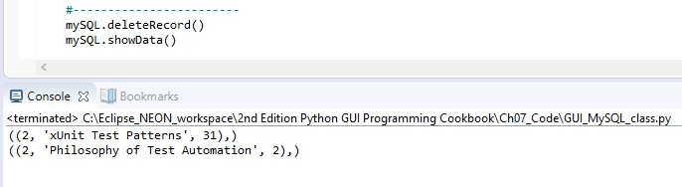
Storing Data in Our MySQL Database via Our GUI
Chapter 7
7. The preceding code results in the following output:

Slide 65
Storing Data in Our MySQL Database via Our GUI Chapter 7
7_ Storing and retrieving data from our MySQL database
We will use our Python GUI to insert data into our MySQL database tables. We already refactored the GUI we built in the previous recipes in preparation for connecting and using a database.
We will use two textbox Entry widgets, into which we can type the book or journal title and the page number. We will also use a ScrolledText widget to type our favorite book quotations into, which we will then store in our MySQL database.

Slide 66
Storing Data in Our MySQL Database via Our GUI Chapter 7
Getting ready
This recipe will build on the MySQL database and tables we created in the previous recipes of this chapter.
How to do it…
We will insert, retrieve, and modify our favorite quotations using our Python GUI. We refactored the MySQL tab of our GUI in preparation for this. Let's look at how we can deal with this:
Open GUI_MySQL.py.
Running the code in this file shows us our GUI:

Slide 67
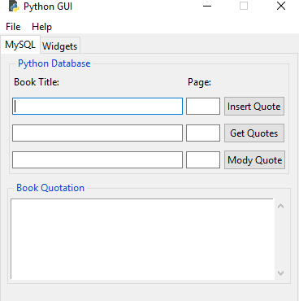
Storing Data in Our MySQL Database via Our GUI Chapter 7
2.Running the code in this file shows us our GUI:

Slide 68
Storing Data in Our MySQL Database via Our GUI
Chapter 7
Open GUI_MySQL.py.
Notice the insertQuote() method, as shown here:
# Adding a Button
self.action = ttk.Button(self.mySQL,text="Insert Quote", command=self.insertQuote)
self.action.grid(column=2, row=1)
# Button callback
def insertQuote(self):
title = self.bookTitle.get()
page = self.pageNumber.get()
quote = self.quote.get(1.0, tk.END)
print(title)
print(quote)
self.mySQL.insertBooks(title, page, quote)

Slide 69
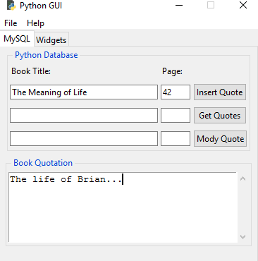
Storing Data in Our MySQL Database via Our GUI
Chapter 7
Run GUI_MySQL.py, enter a quotation, and click the Insert Quote button:

Slide 70
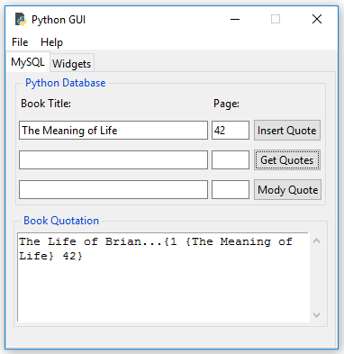
Storing Data in Our MySQL Database via Our GUI
Chapter 7
6. Click Get Quotes:

Slide 71
Storing Data in Our MySQL Database via Our GUI
Chapter 7
Open GUI_MySQL.py and look at the getQuote method and button:
# Adding a Button
self.action1 = ttk.Button(self.mySQL,text="Get Quotes", command=self.getQuote)
self.action1.grid(column=2, row=2)
# Button callback def getQuote(self):
allBooks = self.mySQL.showBooks()
print(allBooks)
self.quote.insert(tk.INSERT, allBooks)

Slide 72
Storing Data in Our MySQL Database via Our GUI
Chapter 7
Open GUI_MySQL.py and look at self.mySQL and showBooks():
from Ch07_Code.GUI_MySQL_class import MySQL
class OOP():
def init (self):
# create MySQL instance
self.mySQL = MySQL()

Slide 73
Storing Data in Our MySQL Database via Our GUI
Chapter 7
class MySQL():
#------------------------------------------------------
def showBooks(self):
# connect to MySQL
conn, cursor = self.connect()
self.useGuiDB(cursor)
# print results
cursor.execute("SELECT * FROM Books")
allBooks = cursor.fetchall()
print(allBooks)
# close cursor and connection
self.close(cursor, conn)
return allBooks

Slide 74
Storing Data in Our MySQL Database via Our GUI Chapter 7
8_ Using MySQL Workbench
MySQL has a very nice GUI that we can download for free. It's called MySQL Workbench.
In this recipe, we will successfully install Workbench and then use it to run SQL queries against the GuiDB we created in the previous recipes.
Getting ready
In order to use this recipe, you will need MySQL database we developed in the previous recipes. You will also need a running MySQL server.

Slide 75
Storing Data in Our MySQL Database via Our GUI Chapter 7
How to do it…
We can download MySQL Workbench from the official MySQL website:
https://dev. mysql.com/downloads/workbench/.

Slide 76
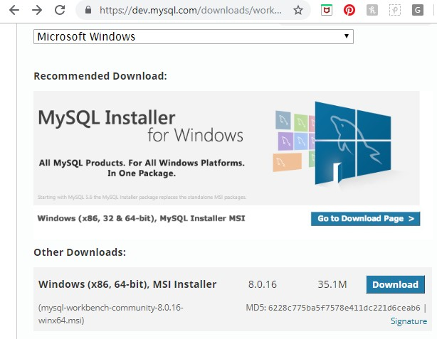
Storing Data in Our MySQL Database via Our GUI
Chapter 7
Let's look at how we can perform this recipe:
Download the MySQL Workbench installer.
Click the Download button:

Slide 77
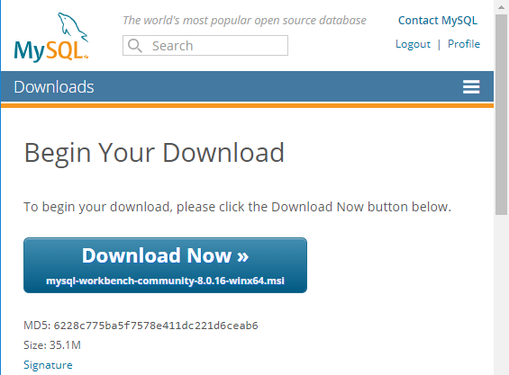
Storing Data in Our MySQL Database via Our GUI
Chapter 7
3. Run the installation:

Slide 78
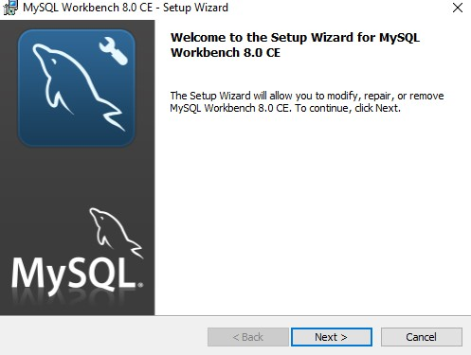
Storing Data in Our MySQL Database via Our GUI
Chapter 7
4. Click Next > until the installation is complete:

Slide 79
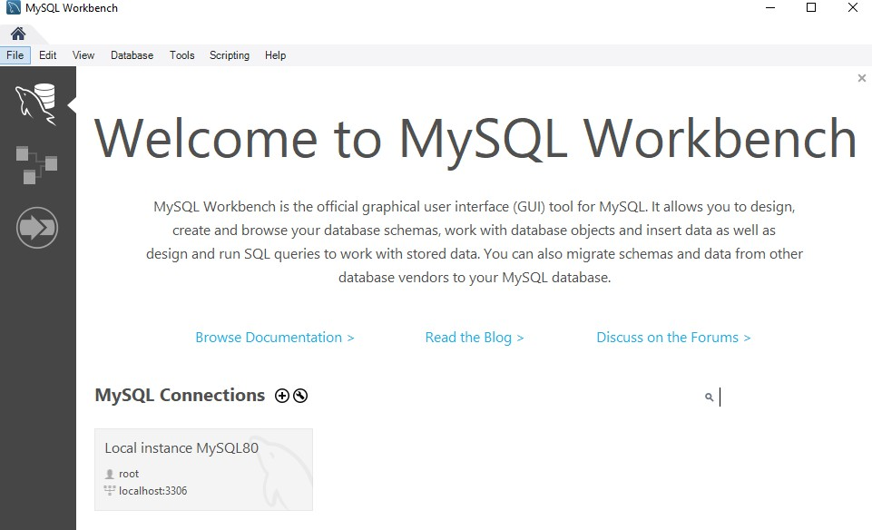
Storing Data in Our MySQL Database via Our GUI
Chapter 7
5. Open MySQL Workbench:

Slide 80
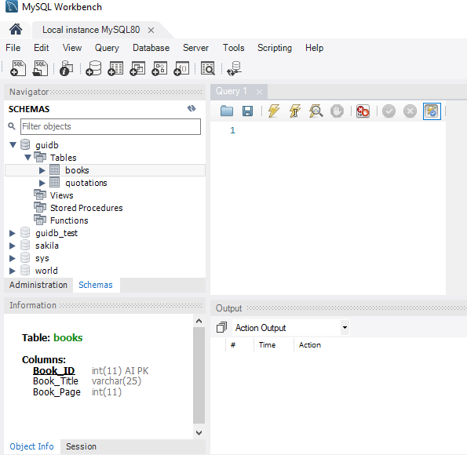
Storing Data in Our MySQL Database via Our GUI
Chapter 7
6. Select our guidb:

Slide 81
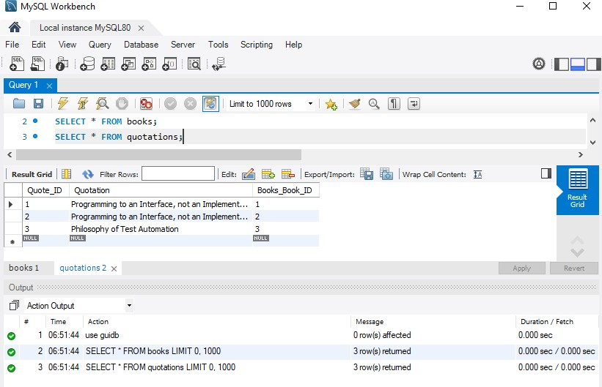
Storing Data in Our MySQL Database via Our GUI
Chapter 7
7. Write and execute some SQL commands:

Slide 82


Storing Data in Our MySQL Database via Our GUI Chapter 7
We can type SQL commands into the Query Editor and execute our commands by clicking the lightning bolt icon. It is the button toward the top right, as shown in the following screenshot:

